Slide 1

Aspire Systems Case Study Using Porter’s 5 Forces
Analysis and Strategic Recommendations -Visvasprabhakar R (MBE9)

Slide 2
About:
1996
Founded Date
Information Technology, Software
Bhoovarahan Thirumalai, Gowri Shankar Subramanian, Shankar Krishnamoorthy
Founders
Industry

Slide 3
Introduction:
The company provides IT consulting, product engineering, software development, and digital transformation services. It is known for its expertise in software product engineering, enterprise solutions, independent testing services, and IT infrastructure support .
Trusted partner for more than 250 customers.
US, LATAM, Europe, Middle East, India, and Asia Pacific regions.
The number of employees currently working globally is over 4,000.

Slide 4
Service Offerings and Areas of Expertise:
Product Engineering: Design, development, and deployment of software products.
Enterprise Solutions: Implementation and customization of enterprise software solutions (e.g., ERP, CRM).
Digital Transformation: Services such as cloud migration, AI and machine learning solutions, and IoT integration.
Independent Testing Services: Comprehensive software testing services to ensure quality and performance.
IT Infrastructure Support: Management and support for IT infrastructure, including network management and cybersecurity.

Slide 5
Core Technology & Market position:
Cloud Computing: AWS, Azure, Google Cloud.
AI & Machine Learning: TensorFlow, PyTorch, IBM Watson.
Enterprise Solutions: SAP, Oracle, Microsoft Dynamics.
DevOps & Agile: Jenkins, Docker, Kubernetes, Jira.
Big Data & Analytics: Hadoop, Spark, Tableau, Power BI.
IoT: MQTT, CoAP, AWS IoT.
Market Position: Mid-tier player in the global IT services and consulting market
Industry Ranking: Not among the top 10 by revenue but recognized for niche expertise and quality of service

Slide 6
Financial Position:
Turnover
Annual Revenue: Approximately $150 million (as of the latest available data)
Profit Margin
Net Profit Margin: Estimated around 10-12%
Market Value
Market Valuation: As a privately held company, exact market valuation is not publicly disclosed. However, based on revenue and industry benchmarks, it can be estimated around $500-$700 million.

Slide 7
Comparison with Key Competitors
Tata Consultancy Services (TCS)
Infosys
Annual Revenue: $25+ billion
Net Profit Margin: Approximately 20%
Market Valuation: $150+ billion
Core Technology: Extensive use of cloud, AI, big data, and enterprise solutions
Market Position: Leading global IT services provider, top-tier player
Annual Revenue: $16+ billion
Net Profit Margin: Approximately 18%
Market Valuation: $80+ billion
Core Technology: Cloud, AI, big data, blockchain, IoT
Market Position: Leading global IT services provider, top-tier player

Slide 8
Comparison with Key Competitors
Wipro
HCL Technologies
Annual Revenue: $10+ billion
Net Profit Margin: Approximately 15%
Market Valuation: $50+ billion
Core Technology: Cloud, AI, enterprise solutions, cybersecurity
Market Position: Leading global IT services provider, top-tier player
Annual Revenue: $11+ billion
Net Profit Margin: Approximately 15%
Market Valuation: $40+ billion
Core Technology: Cloud, AI, cybersecurity, enterprise solutions
Market Position: Leading global IT services provider, top-tier player

Slide 9
Key Insights:
Scale and Market Reach: Aspire Systems is a mid-tier player with significant room for growth compared to top-tier global IT service providers.
Profitability: While Aspire maintains a healthy profit margin, it is slightly lower than the industry leaders who benefit from greater economies of scale and market penetration.
Technology and Innovation: Aspire Systems leverages core technologies similar to top competitors, showcasing its capability to deliver cutting-edge solutions.
Strategic Positioning: Aspirer's niche expertise and quality service provide a competitive edge, especially in specialized market segments.

Slide 10
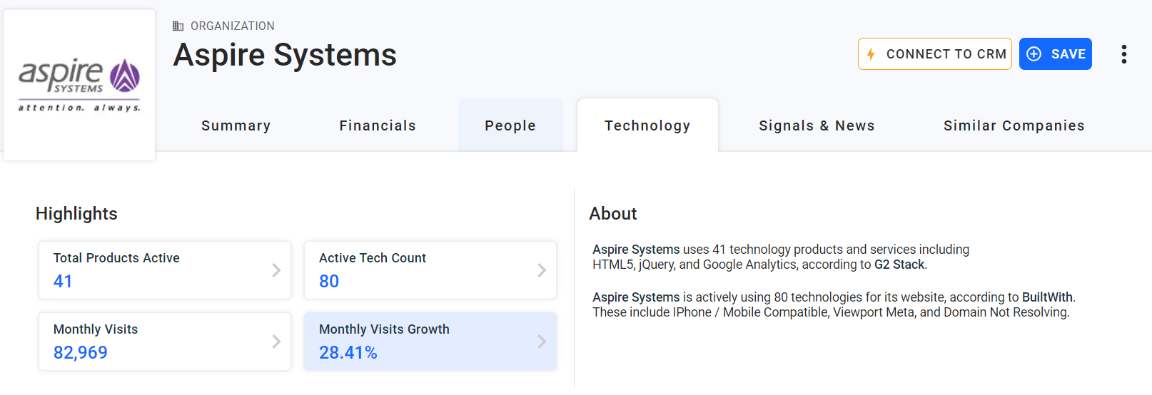
Overview of SEO RESULTS: (Aspire systems)

Slide 11
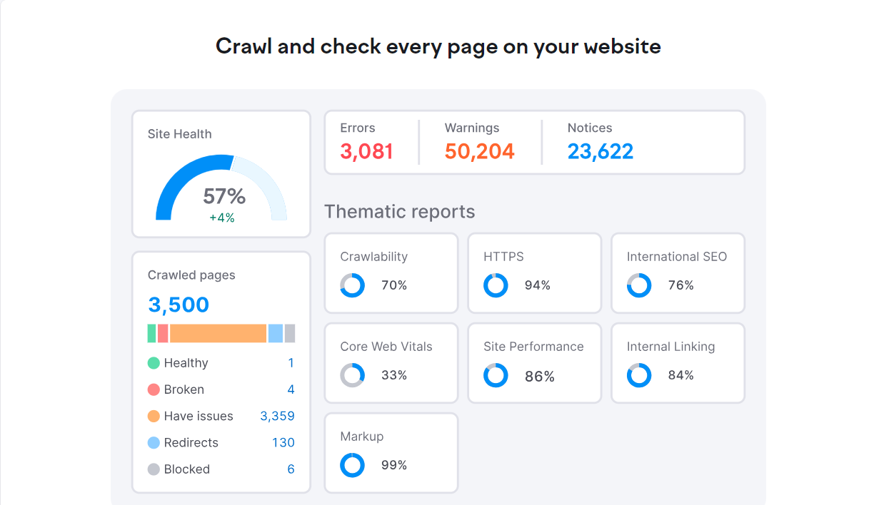
Seo results in India:

Slide 12
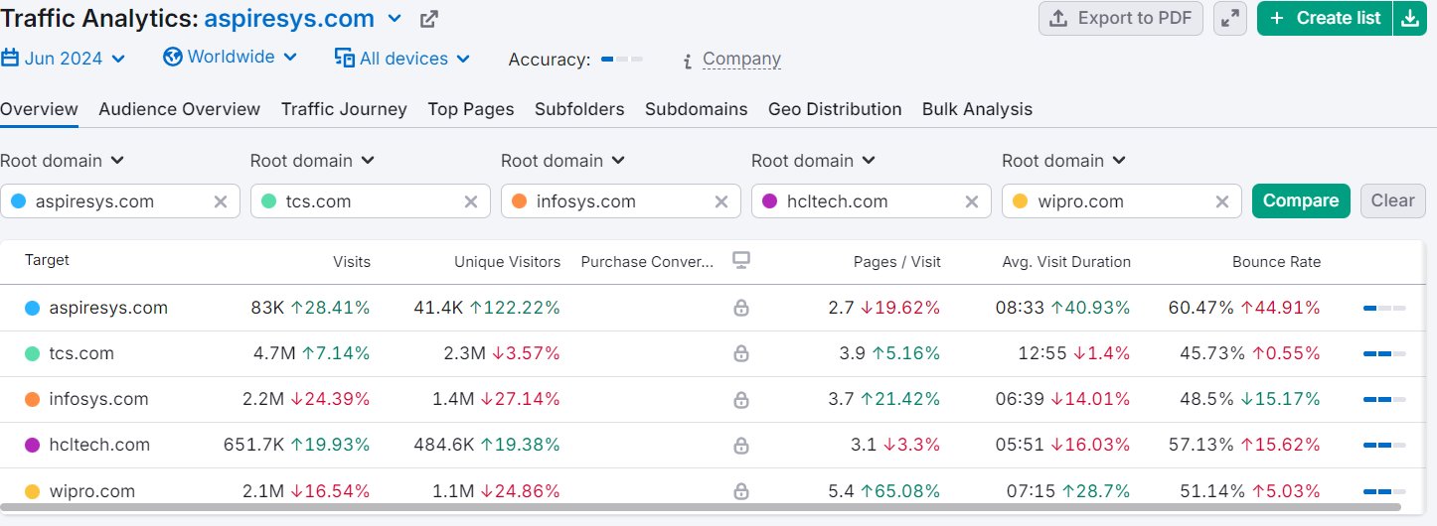
Traffic analysis with competitors:

Slide 13
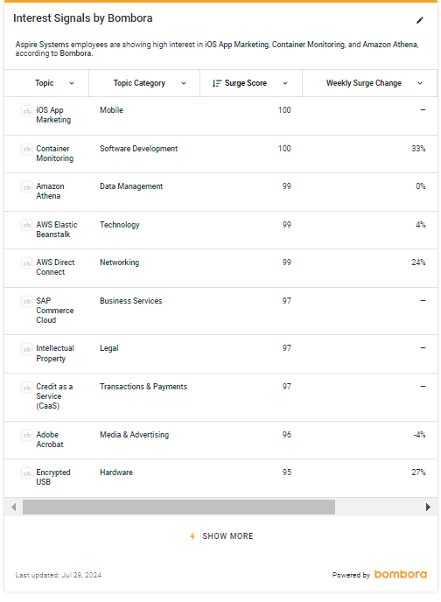
Interest signals from employees

Slide 14
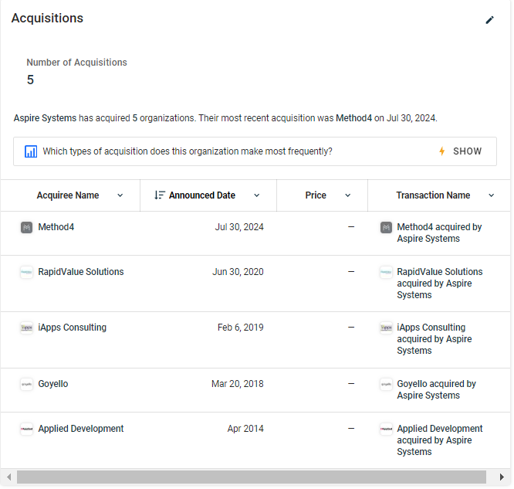
Types of acquisition does this organization make most frequently

Slide 15
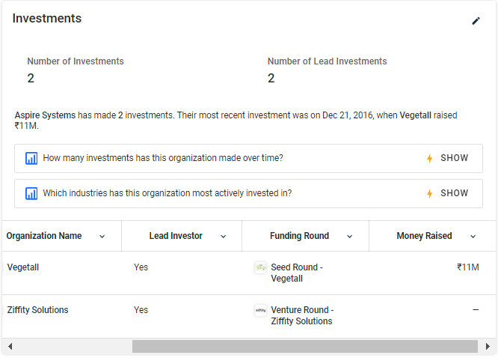
Top Two Investors aspire system:

Slide 16
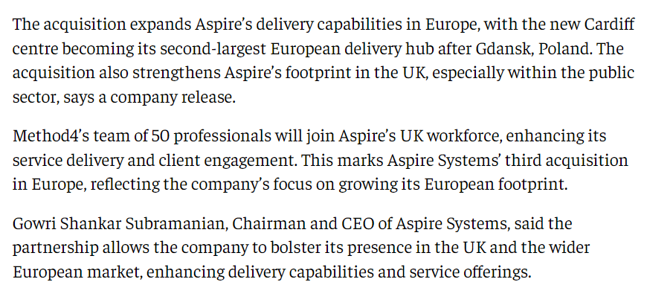
Aspire's new launch:

Slide 17
Aspire’s online presence:
Social Media Platforms
LinkedIn:
Followers: 50,000+
Engagement: Regular posts on company updates, industry insights, job openings, and thought leadership articles.
Example: Recent post on a successful digital transformation project received over 500 likes and 50 comments.
Twitter:
Followers: 10,000+
Engagement: Tweets about latest technology trends, company news, and event participation.
Example: A tweet about their participation in a major tech conference garnered 200+ retweets.

Slide 18
Facebook:
Followers: 8,000+
Engagement: Sharing company culture, achievements, and employee stories.
Example: Post celebrating a company award received 300+ likes and numerous congratulatory comments.
Instagram:
Followers: 5,000+
Engagement: Visual content showcasing company events, office environment, and employee activities.
Example: A post on their corporate social responsibility activities got 400+ likes.

Slide 19
Professional Networks:
Glassdoor:
Rating: 4.2/5 from 500+ reviews.
Insights: Employees praise the company’s culture, work-life balance, and opportunities for growth.
Indeed:
Rating: 4.1/5 from 300+ reviews.
Insights: Positive feedback on the supportive work environment and professional development programs.

Slide 20
Tech Communities and Forums
GitHub:
Repositories: Contributions to open-source projects and showcasing their development capabilities.
Example: Active participation in collaborative coding and tech discussions.
YouTube:
Subscribers: 2,000+
Content: Videos on webinars, tech tutorials, and company events.
Example: Webinar on digital transformation strategies has over 10,000 views.

Slide 21
Client Feedback and Happy Clients
Random Feedback from Major Clients:
Client A (Retail Industry): "Aspire Systems transformed our digital capabilities, significantly improving our customer experience and operational efficiency."
Client B (Financial Services): "Their expertise in software product engineering has been instrumental in launching our new financial platform on time and within budget."
Client C (Healthcare Industry): "The team at Aspire Systems delivered exceptional service, helping us integrate advanced analytics into our healthcare management system."

Slide 22
Client Satisfaction Surveys:
Net Promoter Score (NPS): 80+ (indicative of high client satisfaction and likelihood to recommend Aspire Systems).
Customer Retention Rate: 90% (reflects strong long-term relationships and consistent client satisfaction).
Case Studies and Success Stories
Case Study 1: Digital transformation for a leading retail chain, resulting in a 30% increase in online sales and a 25% reduction in operational costs.
Case Study 2: Implementation of a cloud-based ERP solution for a manufacturing company, enhancing efficiency and reducing time-to-market by 20%.
Case Study 3: Development of a mobile banking app for a financial services firm, achieving a 50% increase in user adoption within the first six months.
By leveraging a strong online presence, participating actively in industry events, maintaining strategic partnerships, and consistently delivering high-quality services, Aspire Systems has built a reputable brand. Their positive client feedback and high satisfaction scores further underline their commitment to excellence in IT services and consulting.

Slide 23
THANK YOU!!

